Slide 1



GEG MIS Expansion to include EmpowerU, PROSPECTS and G4DU
May, 2024

Slide 2

Requirements
1
Pre-Registration
Separation of beneficiary name
2
Registration
Unique beneficiary Identity
Register beneficiary in NSR
School status and back to school
Secondary school transition status
Skill and business details
Disability status
Vulnerability status
Exit status
3
Mentoring
Easy navigation in data entry
4
Grievance
Assign grievance to specific user
Quick access to open grievance
5
Cash Transfer
Creation of email alerts
6
Generate Report
Generation of reports and statistics

Slide 3

BR 1 Separation of beneficiary name

Slide 4
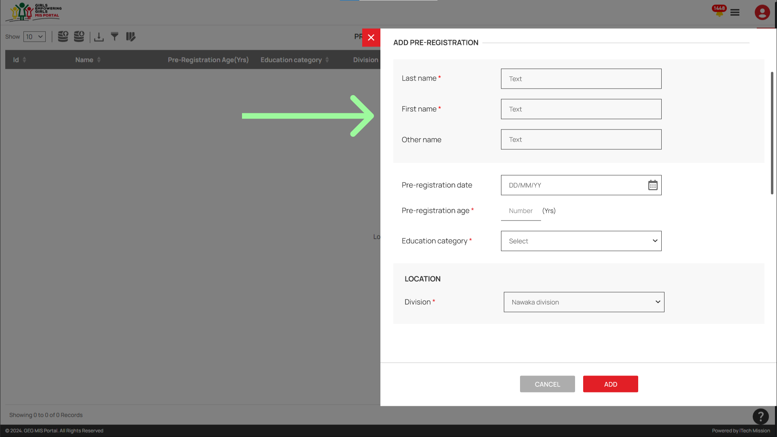
BR 1 Separation of beneficiary name

Slide 5
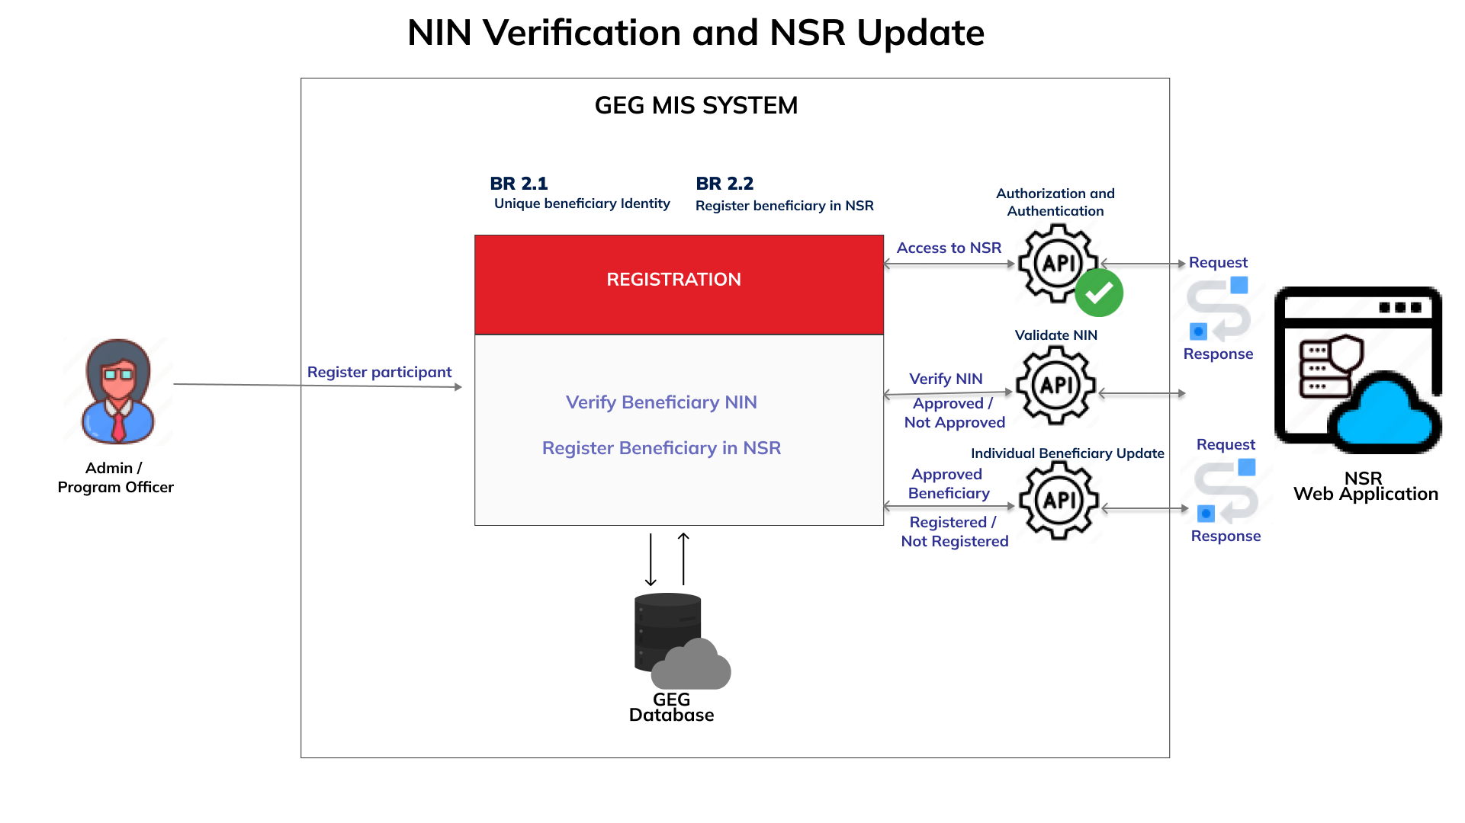
BR 2.1 & 2.2 Unique beneficiary Identity and Register beneficiary in NSR

Slide 6
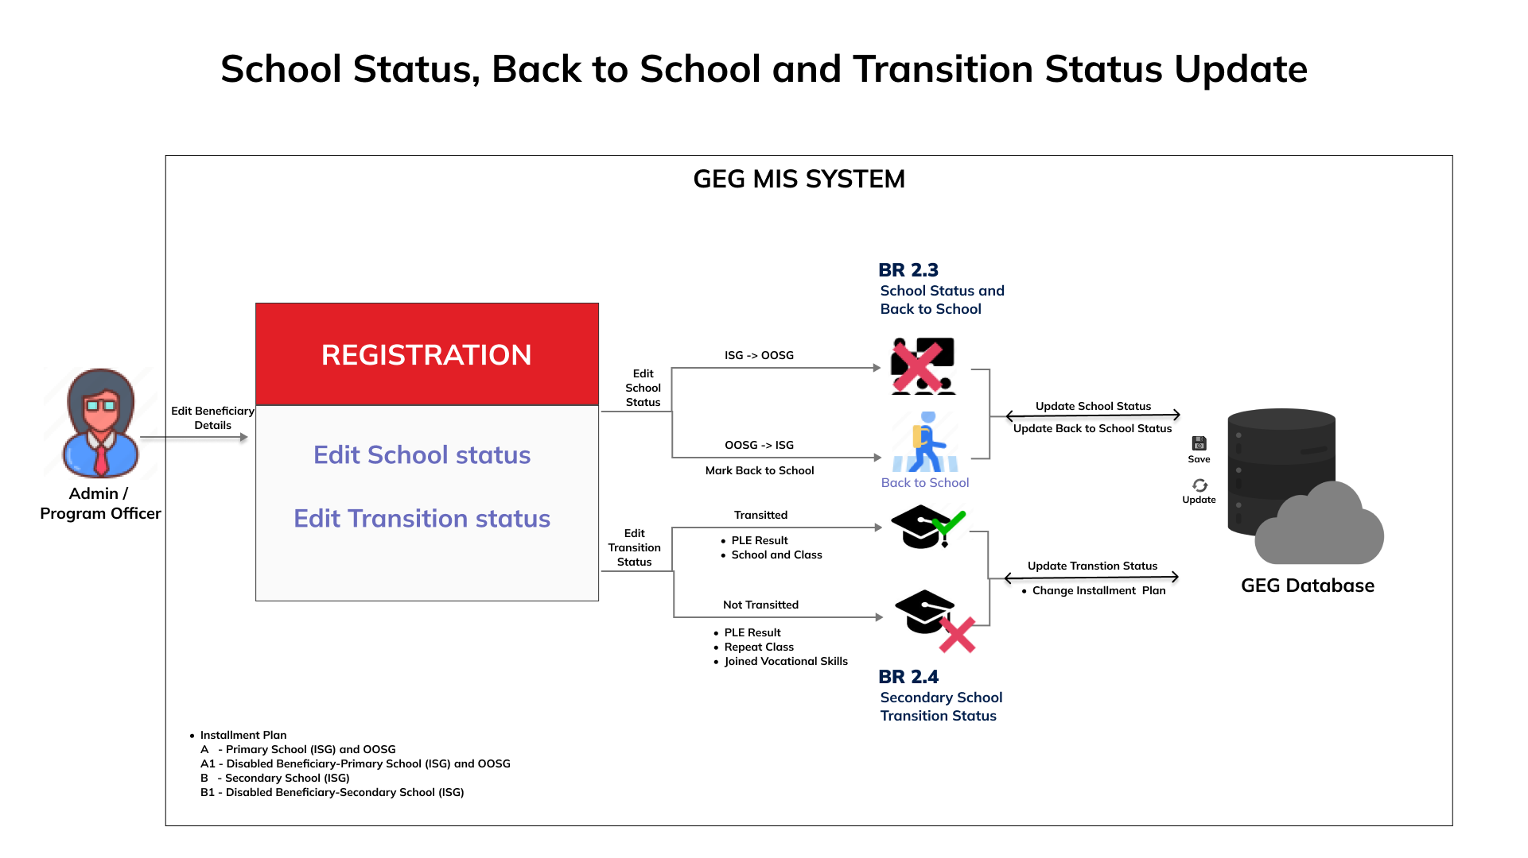
BR 2.3 & 2.4 School status, back to school and Transition Status

Slide 7
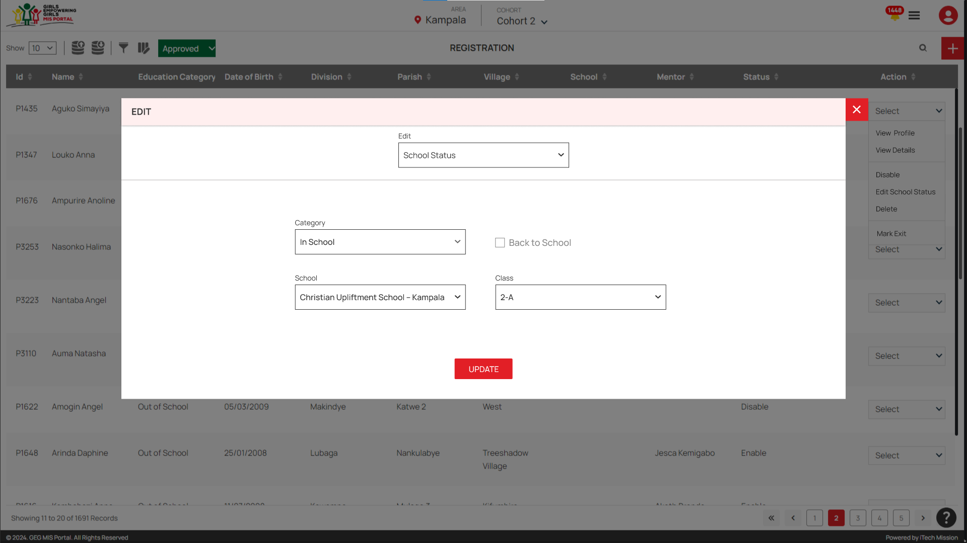
BR 2.3 & 2.4 School status, back to school and Transition Status

Slide 8
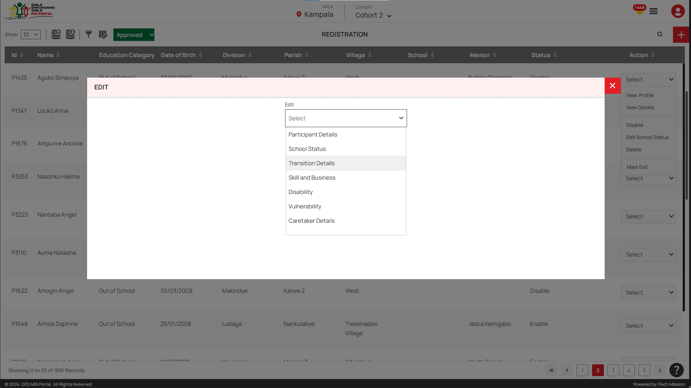
BR 2.3 & 2.4 School status, back to school and Transition Status

Slide 9
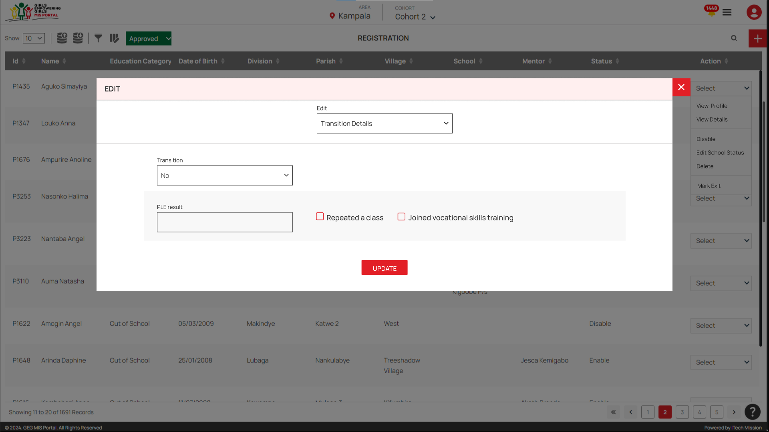
BR 2.3 & 2.4 School status, back to school and Transition Status

Slide 10
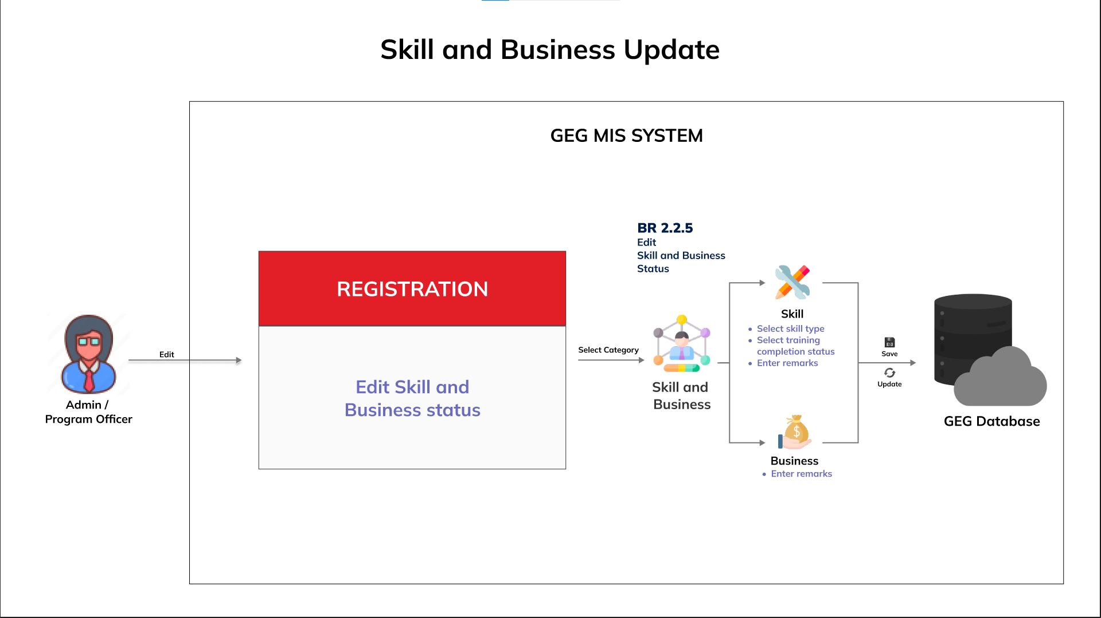
BR 2.5 Skill and business details

Slide 11
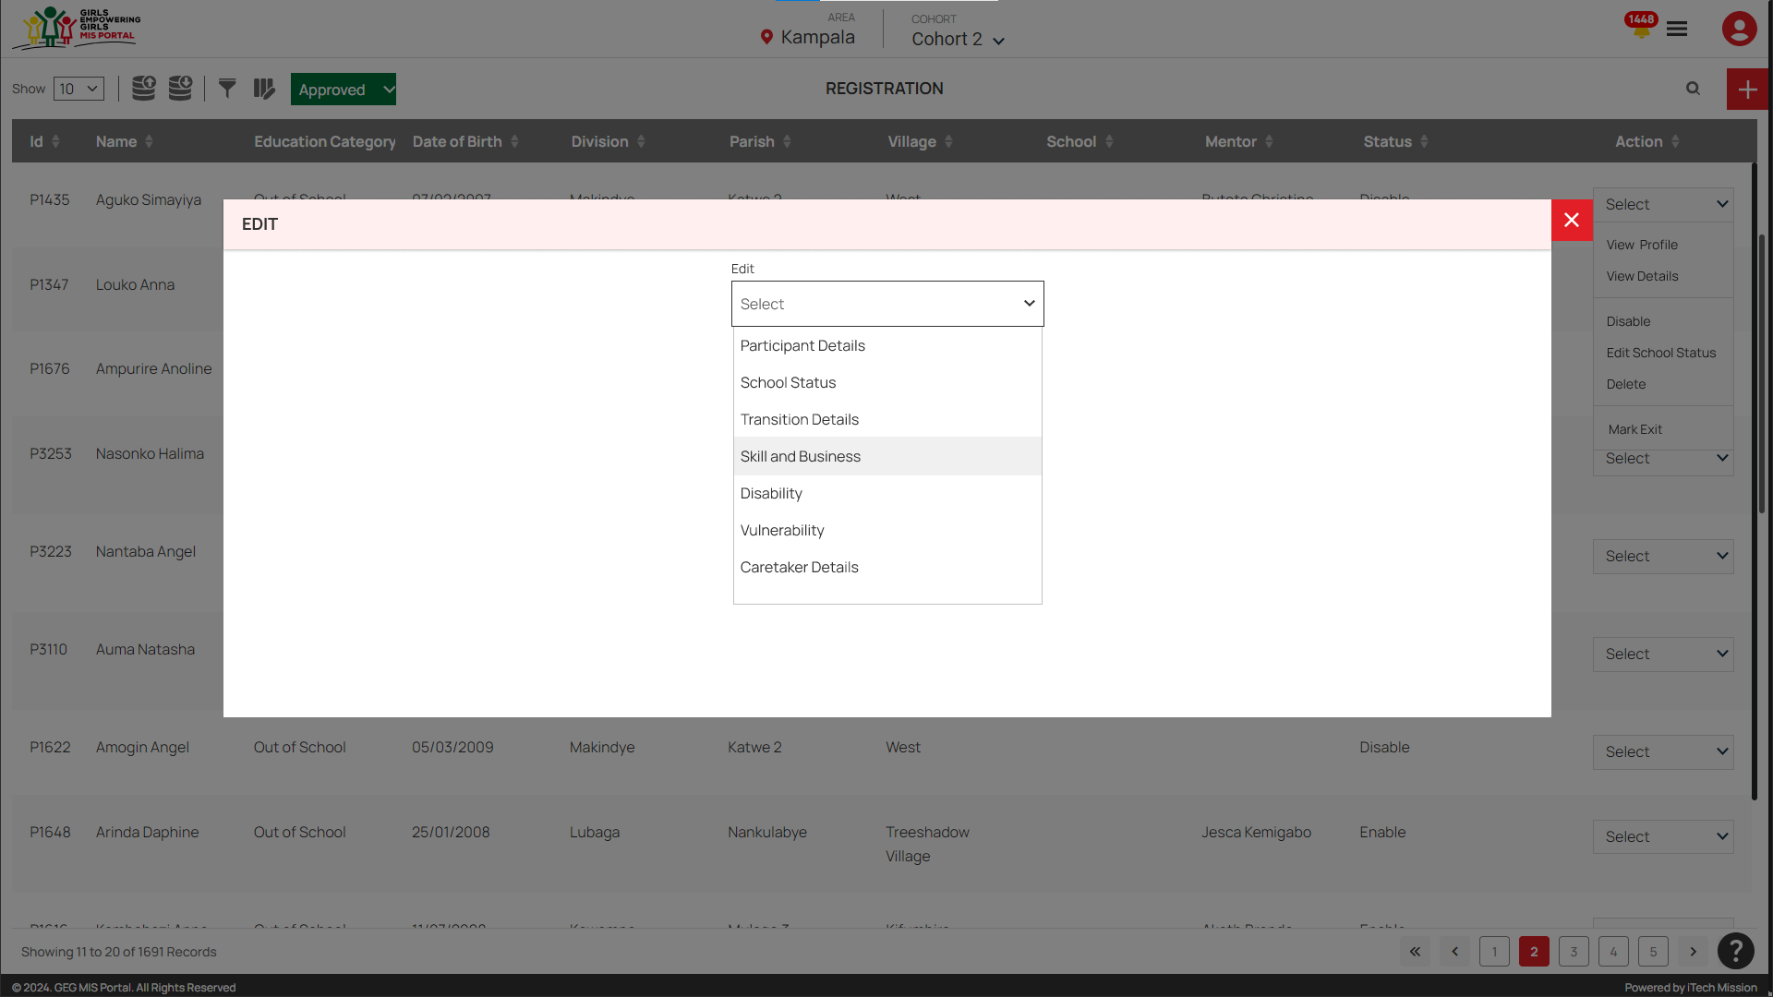
BR 2.5 Skill and business details

Slide 12
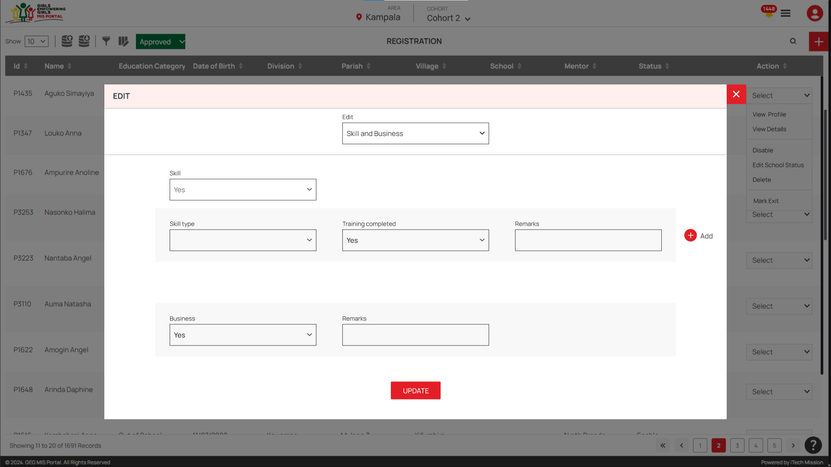
BR 2.5 Skill and business details

Slide 13
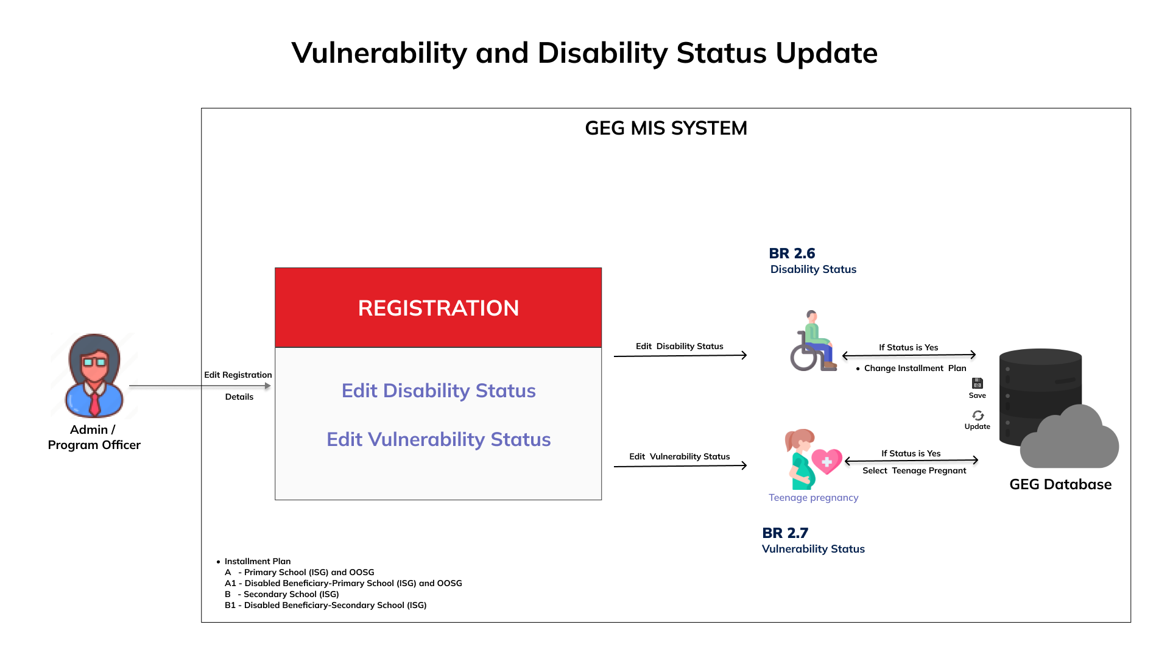
BR 2.6 Disability status

Slide 14

BR 2.6 Disability status

Slide 15
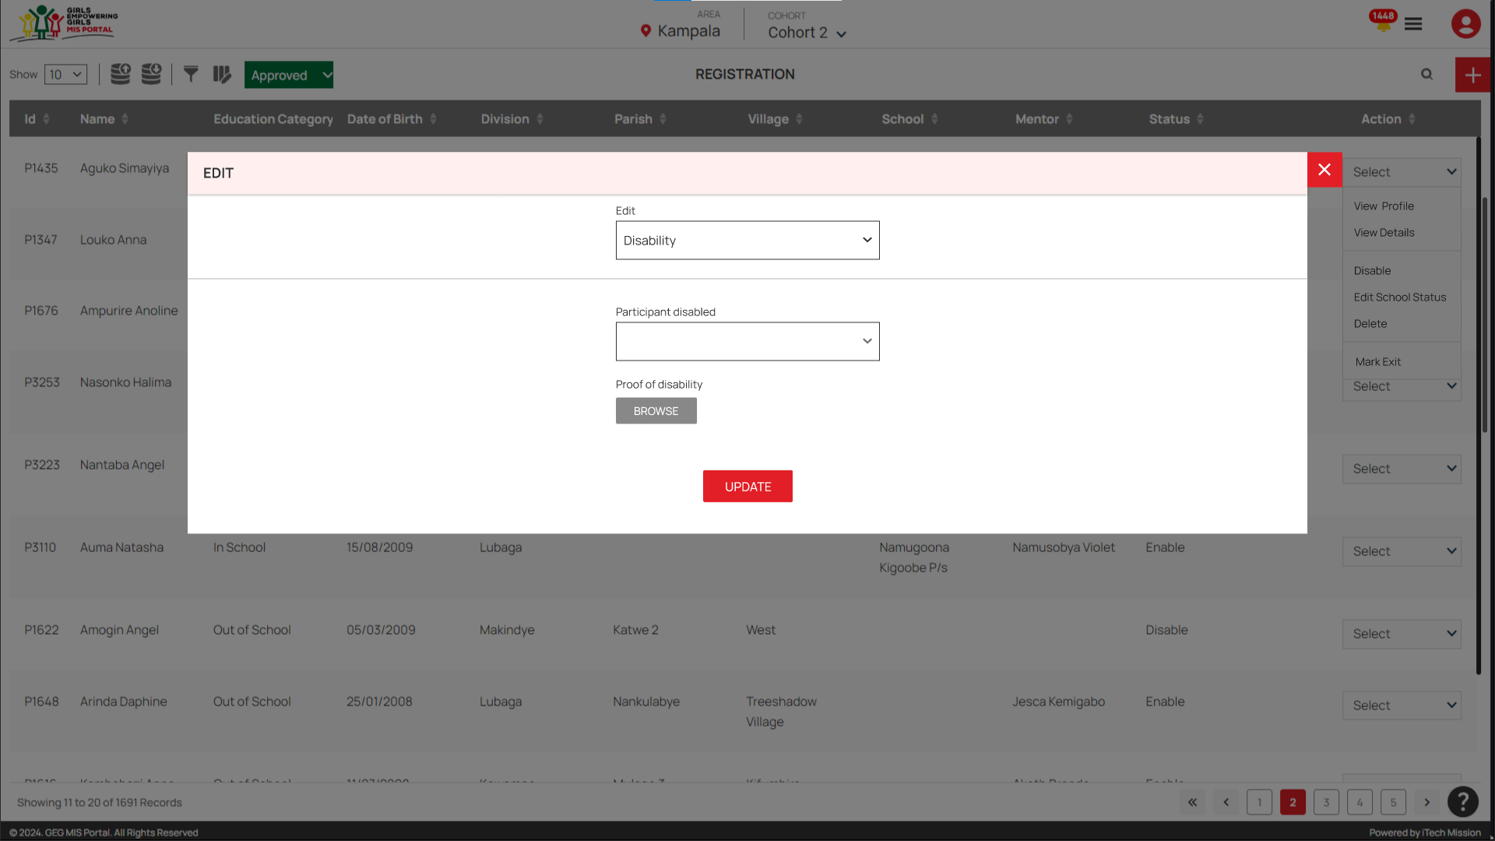
BR 2.6 Disability status

Slide 16
BR 2.7 Vulnerability status

Slide 17

BR 2.7 Vulnerability status

Slide 18
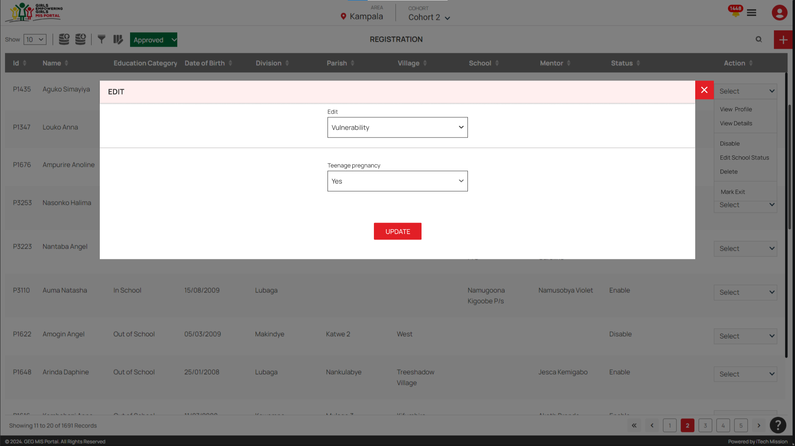
BR 2.7 Vulnerability status

Slide 19
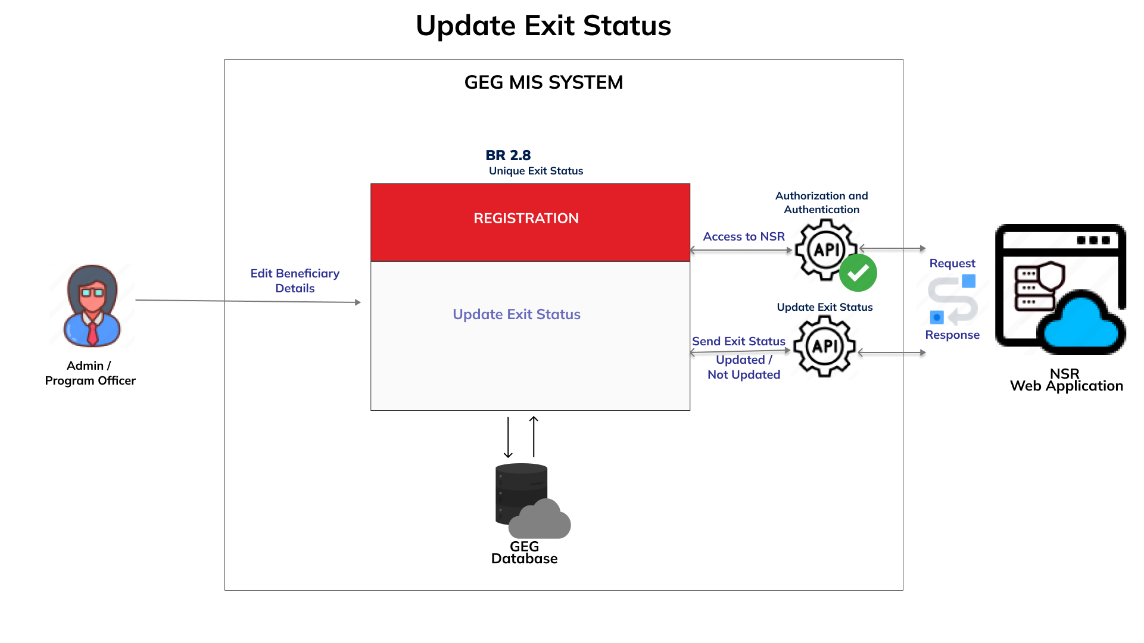
BR 2.8 Exit status

Slide 20
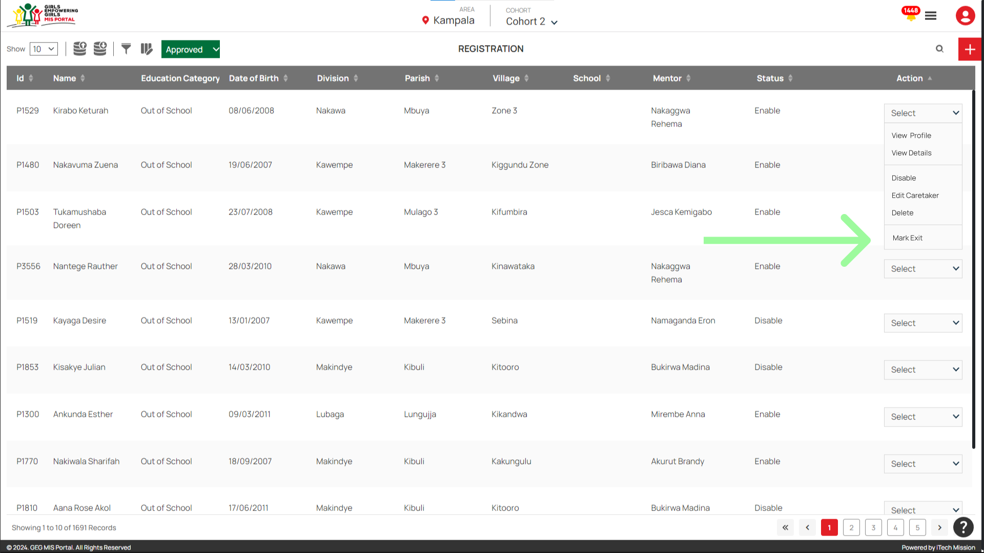
BR 2.8 Exit status

Slide 21
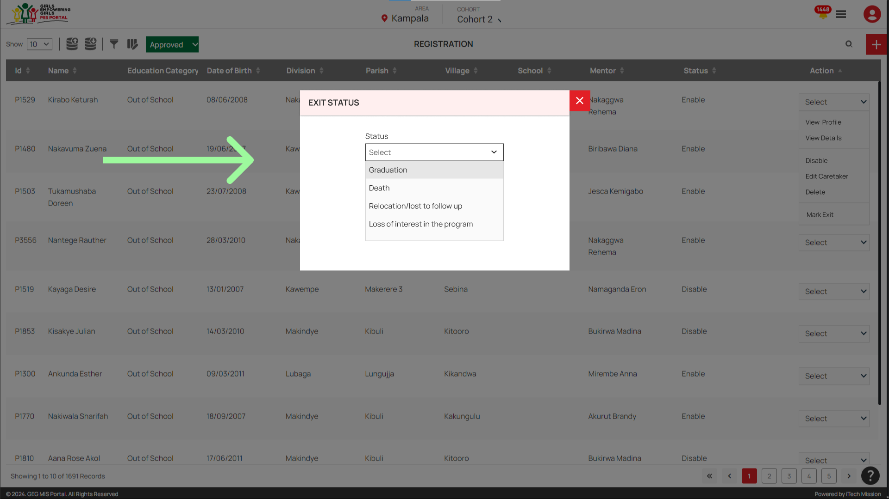
BR 2.8 Exit status

Slide 22
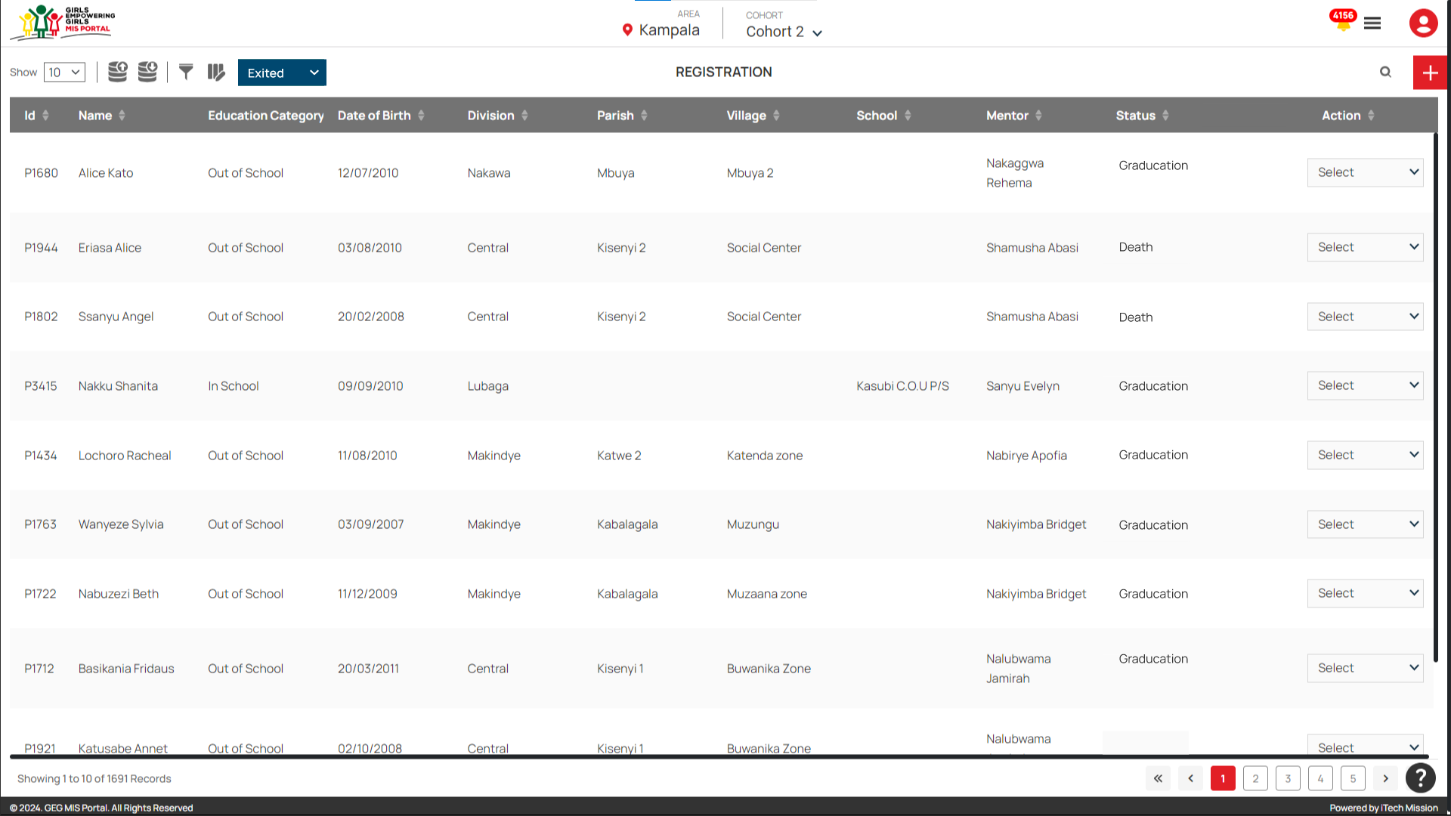
BR 2.8 Exit status

Slide 23
BR 2.9 Download registration data by status
Provide option to filter data by status in the Approved state

Slide 24
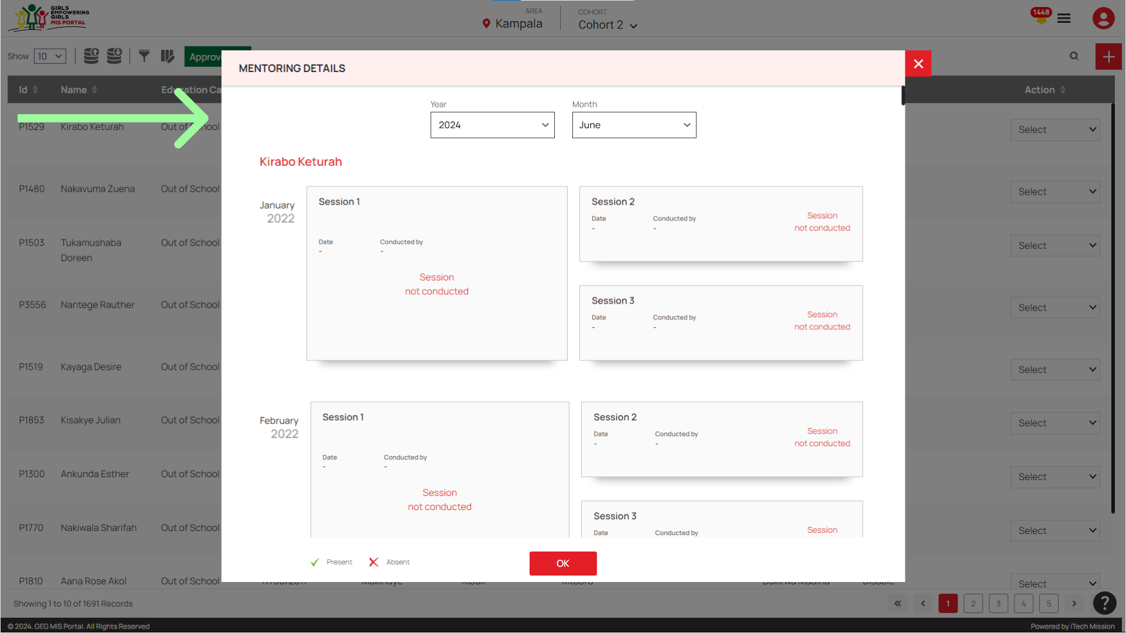
BR 3 Easy navigation in data entry

Slide 25
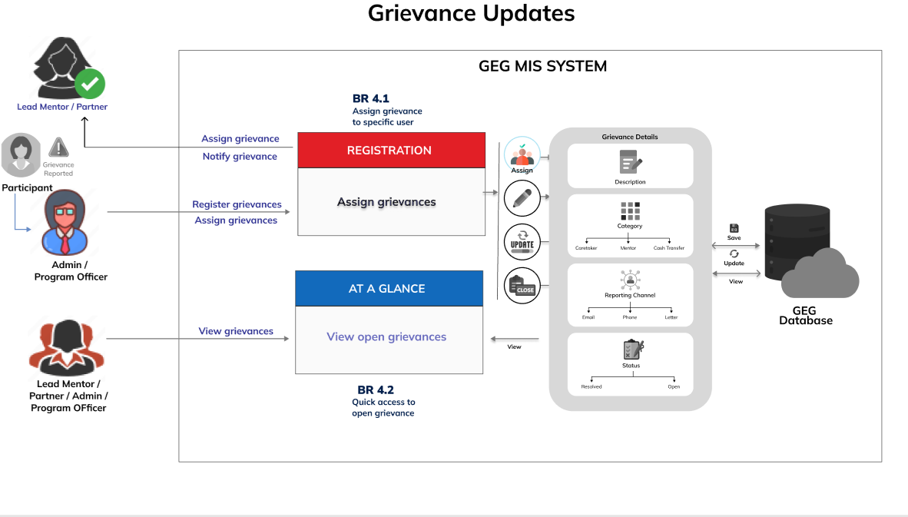
BR 4.1 & BR 4.2 Assign grievance to specific user and Quick access to open grievance

Slide 26
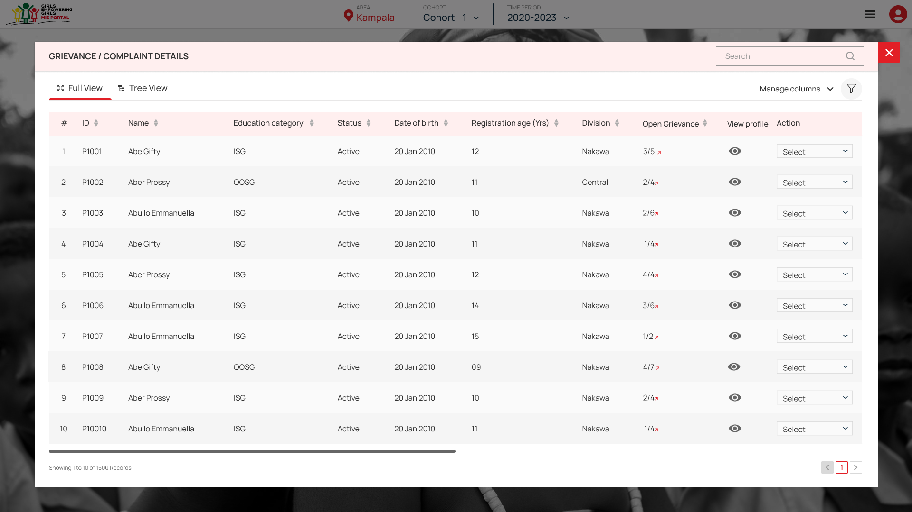
BR 4.1 & BR 4.2 Assign grievance to specific user and Quick access to open grievance

Slide 27
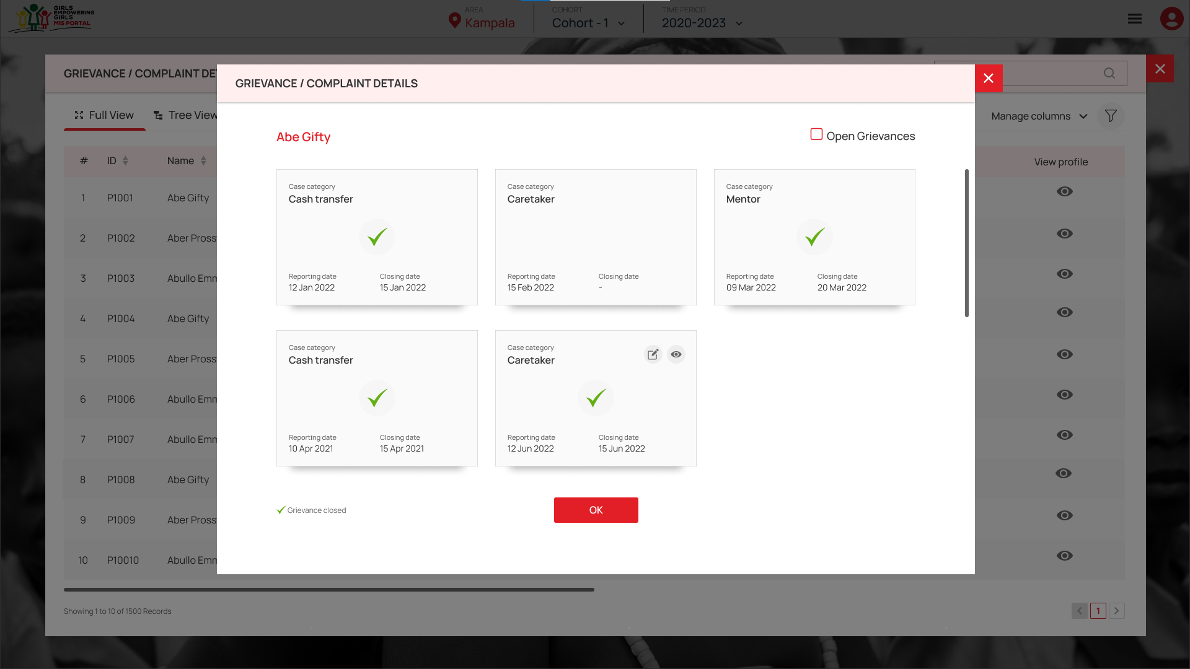
BR 4.1 & BR 4.2 Assign grievance to specific user and Quick access to open grievance

Slide 28
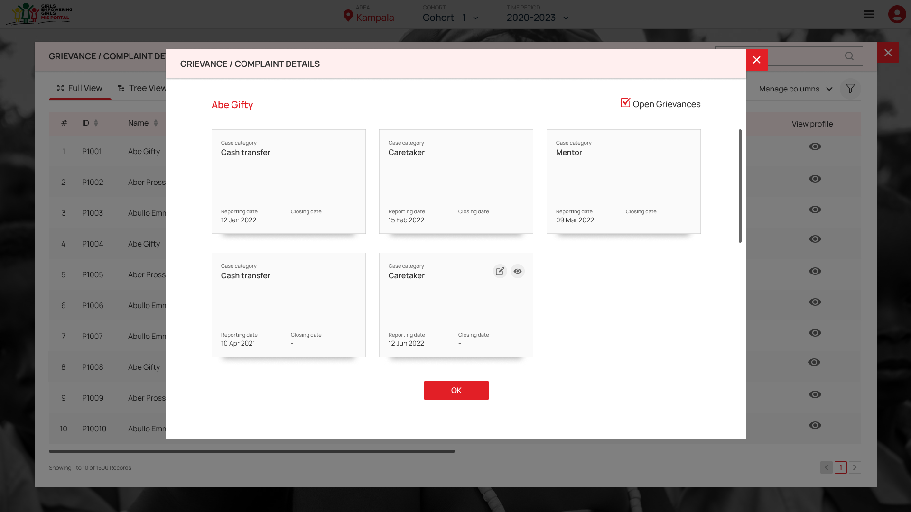
BR 4.1 & BR 4.2 Assign grievance to specific user and Quick access to open grievance

Slide 29
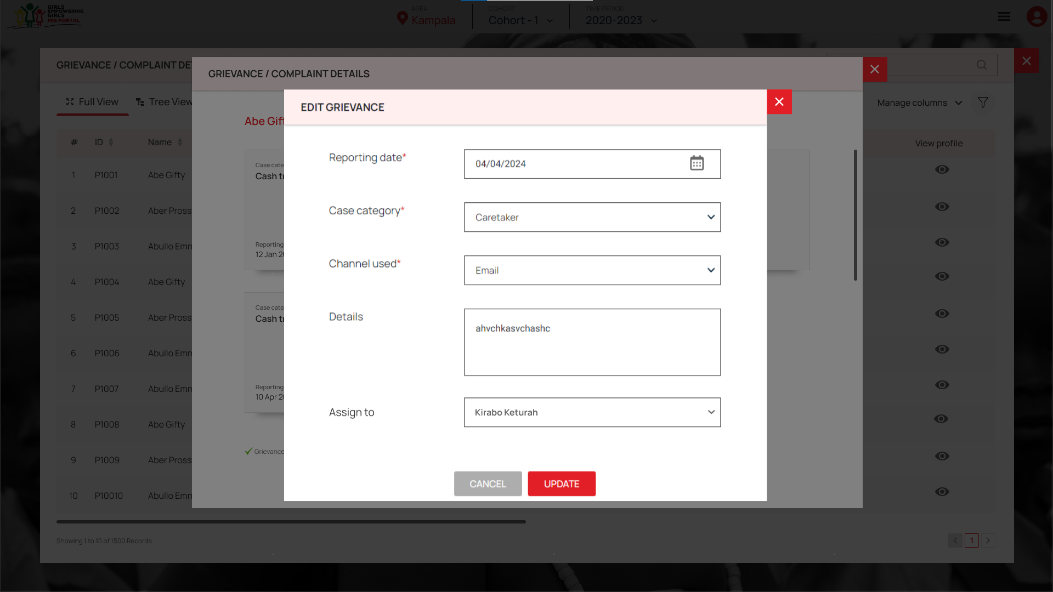
BR 4.1 & BR 4.2 Assign grievance to specific user and Quick access to open grievance

Slide 30
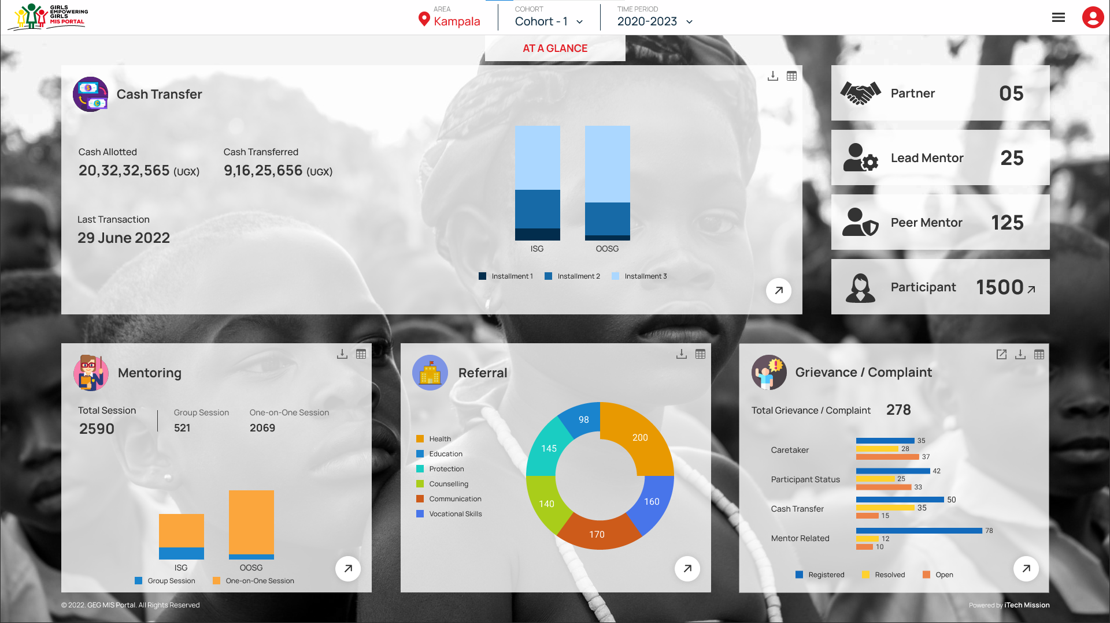
BR 4.1 & BR 4.2 Assign grievance to specific user and Quick access to open grievance

Slide 31
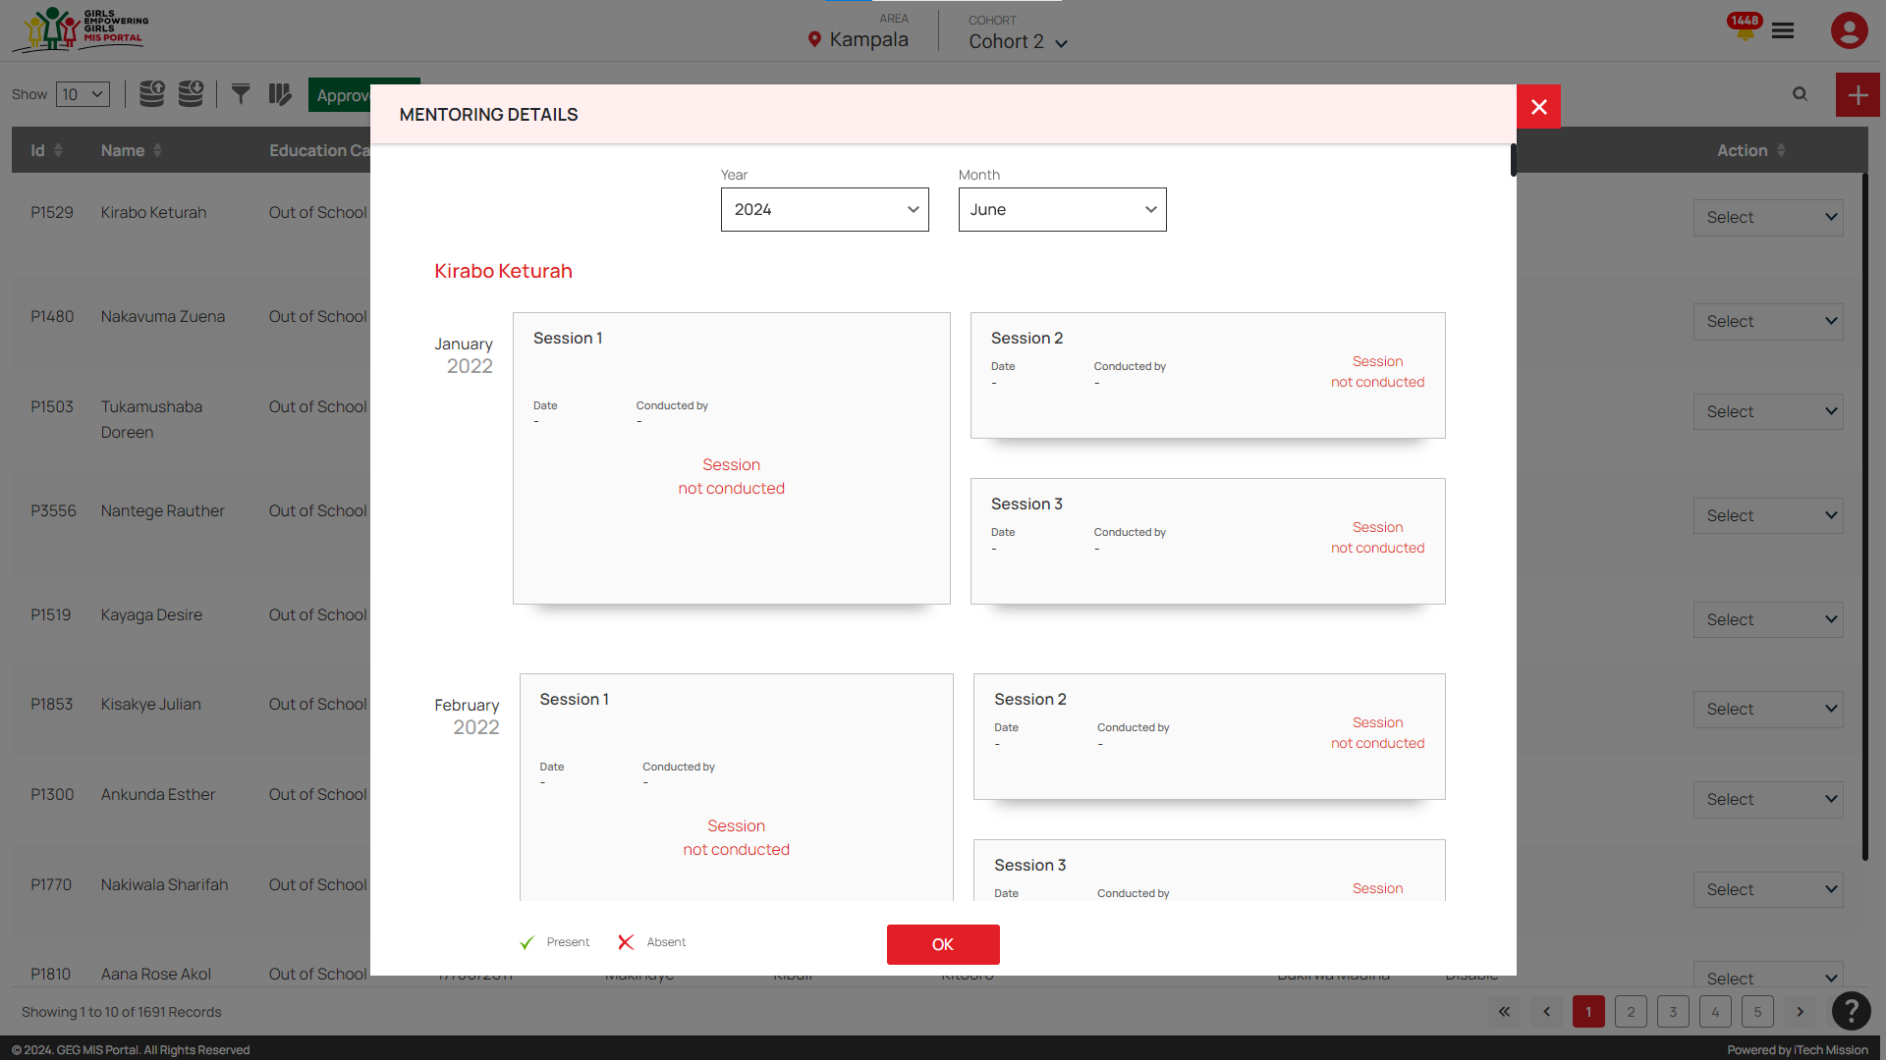
BR 4.1 & BR 4.2 Assign grievance to specific user and Quick access to open grievance

Slide 32
BR 5 Email Alerts
BR 5.1 Email the alerts to the respective users instead of notifications currently implemented in the Cash Transfer Module
BR 5.2 Email the user who is assigned a grievance

Slide 33
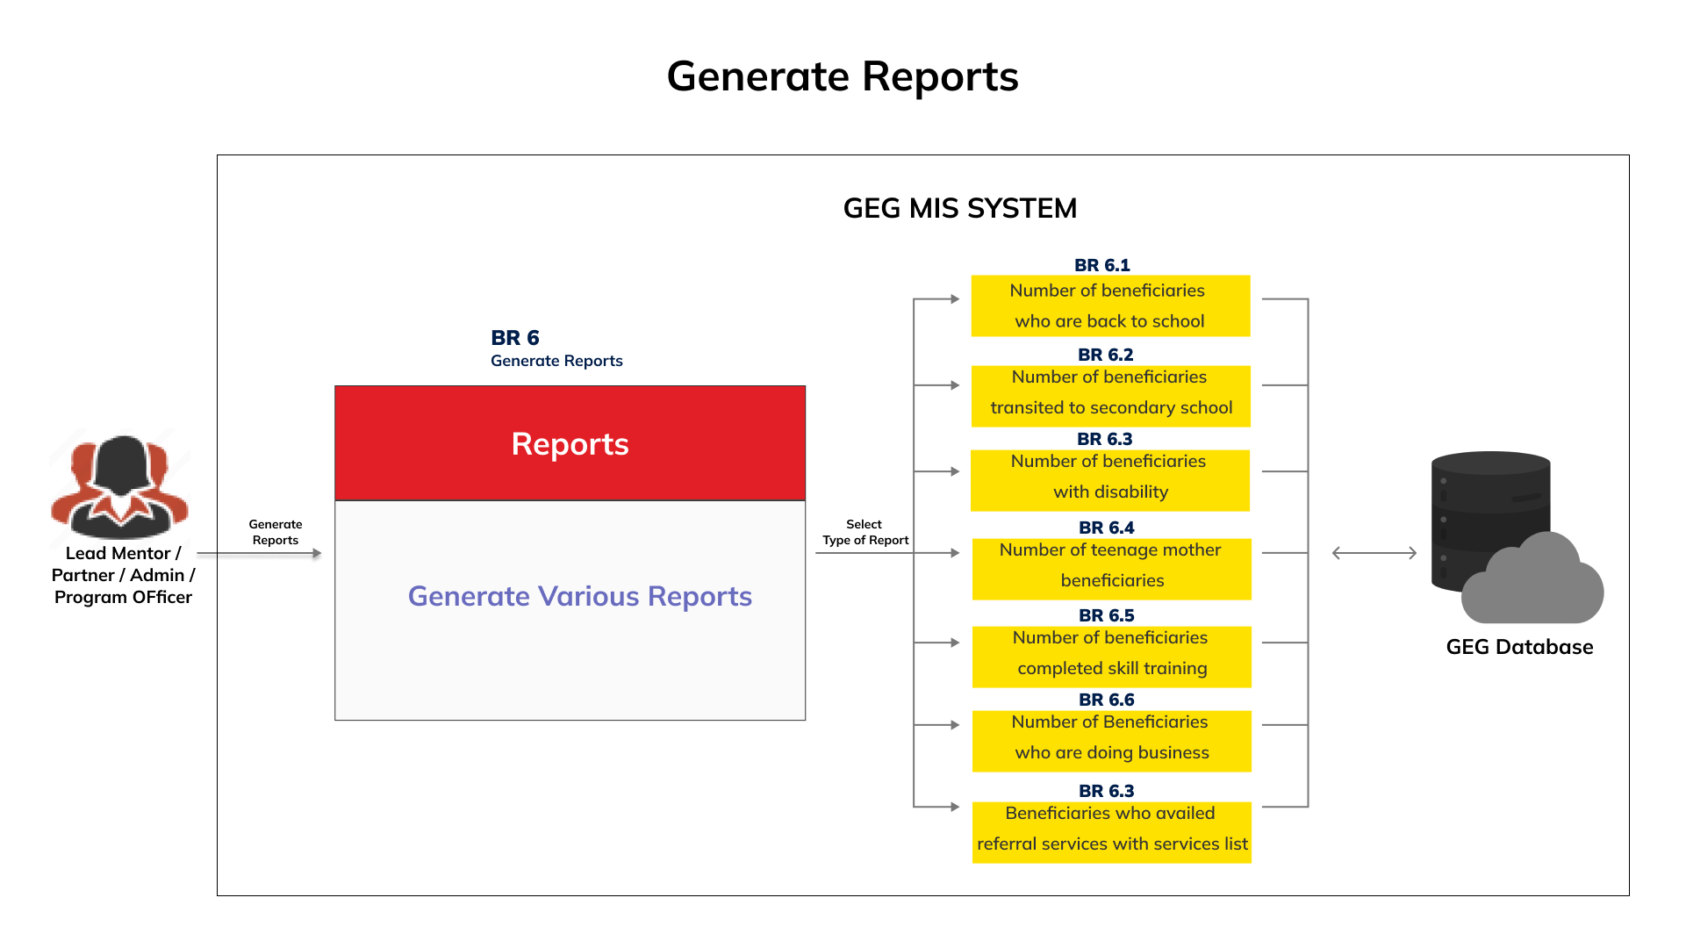
BR 6 Generation of reports and statistics

Slide 34
BR 7 Admin-Cohort Installment Plans Update
Provide option in Cohort Installment Plan to add Installments as
Plan A - Primary School (ISG) and OOSG
PlanA1- Disabled Beneficiary-Primary School (ISG) and OOSG
Plan B- Secondary School (ISG)
PlanB1- Disabled Beneficiary-Secondary School (ISG)

Slide 35




